Slide 1



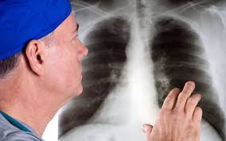
Seneca Therapeutics
Corporate Presentation
Seneca Valley Virus: Expanding the SVV-001 Value Creation Pathway into Multiple Uses
James Hussey, RPh, MBA
Chief Executive Officer
jhussey@senecatherapeutics.com
Paul Hallenbeck, Ph.D
President and Chief Scientific Officer
phallenbeck@senecatherapeutics.com

Slide 2
The Value Creation Pathway of SVV-001
SVV-001 as
monotherapy
oncology agent
SVV-001 Mechanism of Action Known
Master Cell bank complete
Explore usage of Interferon Inhibitors with SVV-001
76 Patient Phase I/II trial as single dose monotherapy complete
SVV-001 in combination with checkpoint inhibitor
Animal efficacy studies complete
Evidence of overcoming T-Cell resistance complete
Phase I/II study protocol in NET/NEC complete
Final IND animal studies ready 1Q22
SVV-001 as Armed Construct delivering gene therapy
Seven Armed Gene Constructs Identified
All seven show evidence of infection with SVV-001
Two armed constructs show evidence to gene expression
Animal studies available by December-March 2022
SVV-001 as Armed Construct delivering pro-drug peptides
Ability to use 3C Proteases in SVV-001 to activate peptide pro-drugs discovered
STI program to develop SVV-001 peptide pro-drugs under consideration
Identification of peptides to start in 4Q21
SVV-001 as multiple IV or IT delivery
Initial Phase I/II trial of SVV-001 was single dose IV
Animal tests used IT dosing for NEC/NET tumors in animals
Planned Phase I/II trial in NEC/NET will use multiple dose IT
Multiple dose IV experiments are ongoing
SVV-001 Companion Diagnostic to screen patients
RT-PCR test has been successfully developed to identify SVV-001 sensitive tumors
This 8 gene set identifies SVV-001 sensitivity using FFPE tumor blocks
A CLIA assay of this 8 gene RT-PCR Test is under development
Understand SVV-001
Expand SVV-001 Uses
Expand SVV-001 Patients

Slide 3
Seneca Therapeutics
SVV-001 as Monotherapy Oncology Agent:
Understanding SVV-001

Slide 4
SVV-001 is Best in Class Among OVs:
RNA OVs (Like SVV) Do Better in the Clinic
Small size enables rapid, potent, and efficient distribution and infection within tumors
SVV is the most cancer specific oncolytic virus (TEM8 mechanism) TEM8 is found on >60% of solid tumors and on most highly-aggressive tumors.
SVV-001 can be used IV unlike most OVs -Unlike most oncolytic viruses SVV is not derived from a human pathogen, nor is it inactivated by human blood
SVV is a platform for gene therapy- transgenes such as tumor antigens and checkpoint inhibitor genes can be inserted and expressed specifically in tumors
Picture sizes proportional proportionally to actual virus size
4
Notes:
I’ll touch on just a few of the many properties that make SVV best in class. The size you see here of each of these oncolytic viruses is proportional to reality. As you can see looking at the far right under RNA viruses and Picornaviradae is that SVV is the smallest oncolytic virus and that imparts many features making it superior. Unlike the larger ones SVV can replicate and spread in tumors very efficiently plus RNA is a potent immune stimulant. SVV is also the most selective and safe oncolytic virus because it is not a human pathogen or derived from one, and utilizes a protein called TEM8 which is very specifically expressed on ~ 2/3 of solid cancer indications. Last SVV is a platform technology as we can put interesting payloads via whats called a transgene in the virus that will only be expressed in the tumor. The list is endless but for example can put in a gene that will also help to kill many of the bad actors in the tumor microenvironment as well.

Slide 5
TEM8—the target for SVV--is expressed on >60% of Solid Cancers
Data From Testing Broad Institute Cancer Cell Line Encyclopedia (CCLE)
Permissive as monotherapy
Permissive with type 1 IFN inhibitor
Not permissive
SVV alone
SVV with addition of transient Type I IFN inhibitor
…so up to 60% solid cancer tumors could be susceptible to SVV
Notes:
We’ve done some further analysis of TEM8 expression and to summarize we now know that TEM8 is found at high enough concentrations in almost all solid cancer indications that SVV should infect and kill those tumor cells by SVV alone (dark green) including sarcoma and other neuroendocrine cancers we already have promising clinical data on youll see on the next slide. For the light green bars we just need to add a transient Type IFN inhibitor to elicit replication and cause many of those tumors to turn hot and respond to a checkpoint inhibitor.

Slide 6
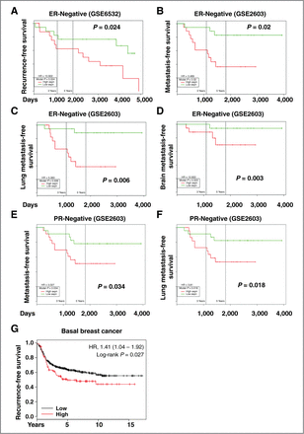
Breast Cancer
SVV-001 Selectively Binds to TEM8. SVV-001 is both highly tumor specific and has a companion diagnostic.
All cancers examined to date demonstrate an adverse correlation of clinical outcome and TEM8 expression
  Breast cancer
  Colon cancer
  Cervical cancer
  Thyroid cancer
  Osteosarcoma
TEM8 provides opportunity to define population where SVV-001 mediated therapy can make a major impact in the clinic
Chen et al. 2013 Cancer Research

Slide 7
SVV-001 has demonstrated activity and safety as a single intravenous infusion in patients with Neuroendocrine tumors
Carcinoid Cancer
Time to Progression/Days
195+ days Mean Progression Free Survival
271
76
CXCL10 (IP-10) - - + + + + - (TNFα)
CXCL10 and TNFα are known predictors of immunotherapy response. Correlation with patients who had SVV infection and clinical benefit. Same 5/6 Patients that had an SVV “infection” in tumor had longer progression free survival and expressed either CXCL10 or TNFα. 0/2 that had no infection (NI) had short PFS and did not express either CXCL10 or TNFα
7

Slide 8
Seneca Therapeutics
SVV-001 In Combination with Checkpoint Inhibitors

Slide 9
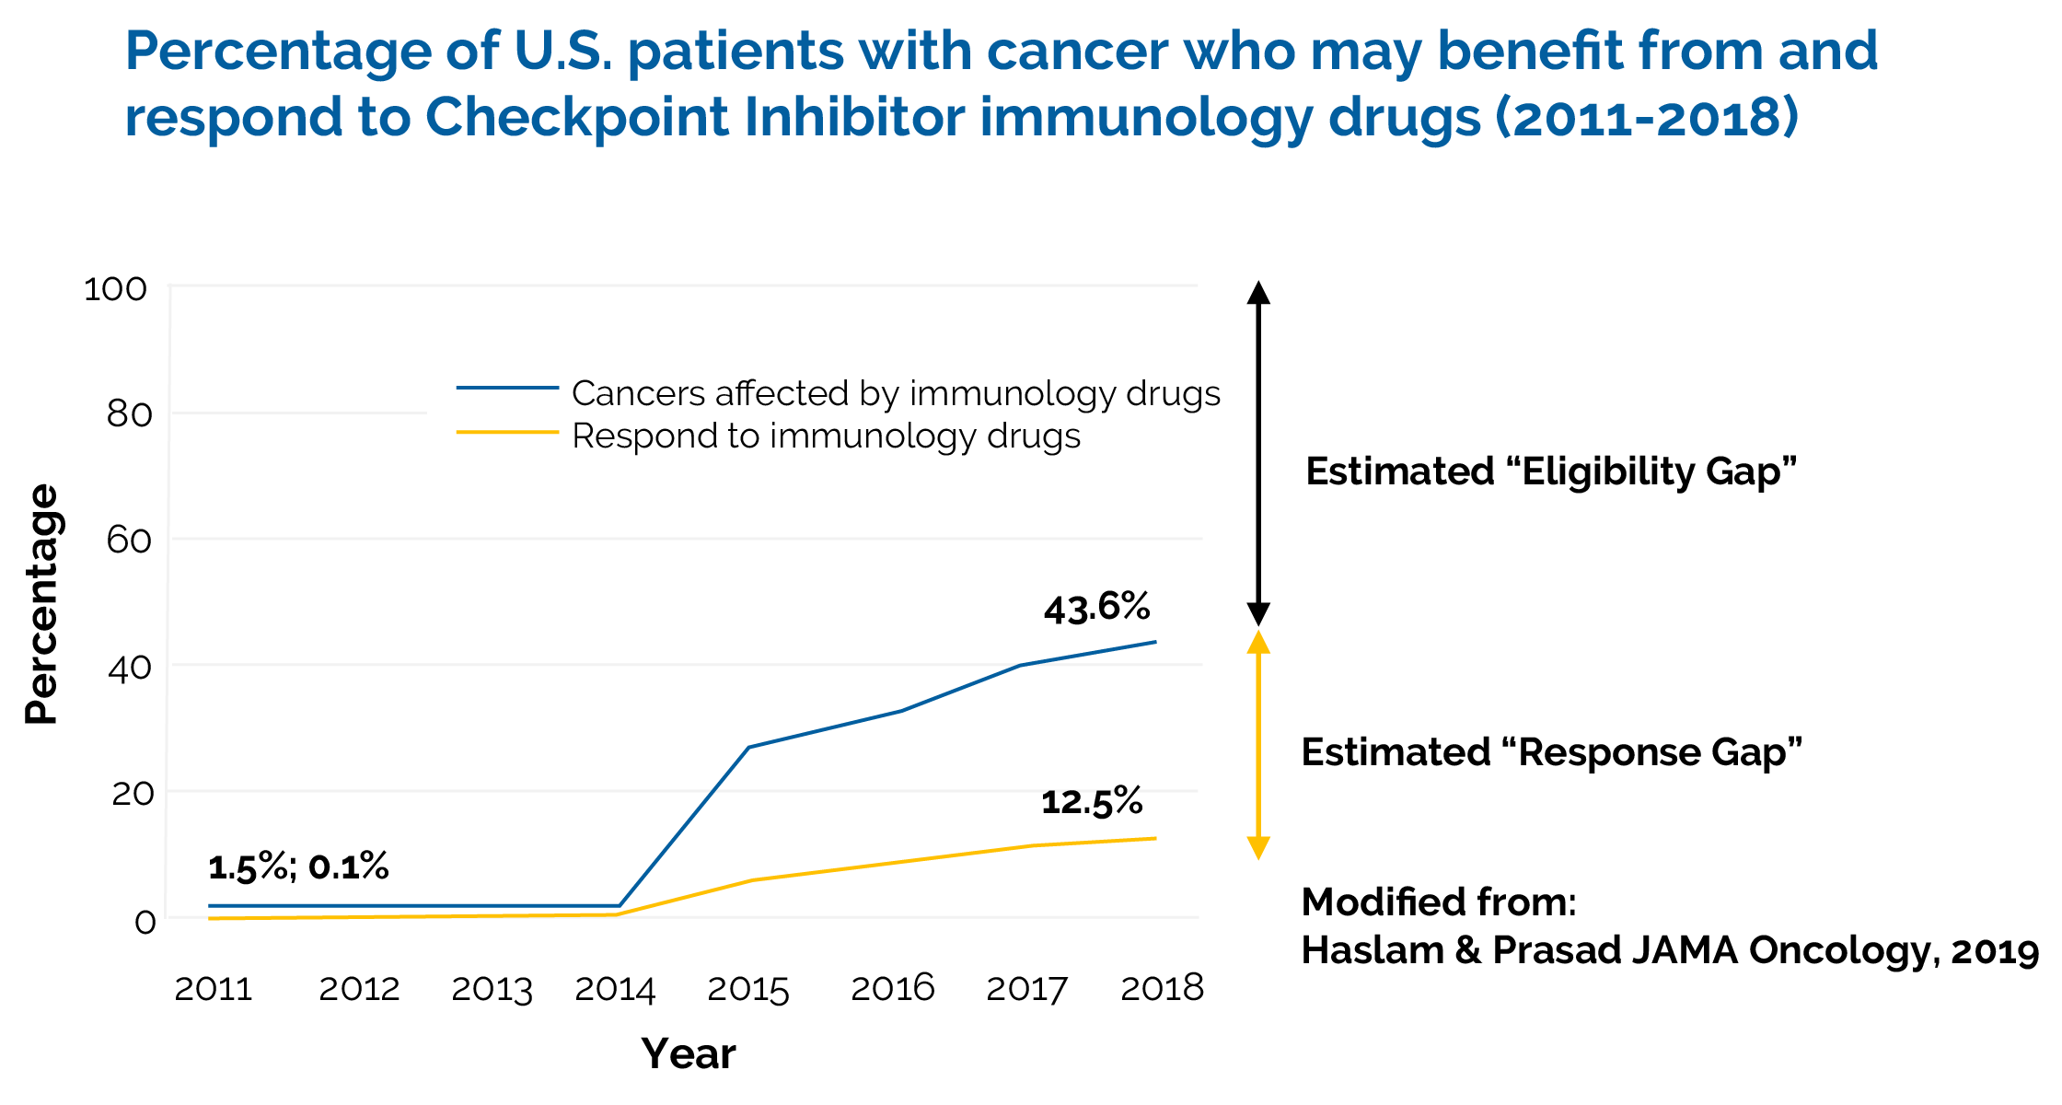
The Problem of “Cold” Tumors: Checkpoint Inhibitors Work Well for Small Subset of the Potential Patients who have “Hot” Tumors
Notes:
And last here you can see what we have already achieved. Love to have you as part of the team where together we can make a difference to cancer patients and have a good chance to get a nice ROI in a relatively short period of time as well. With that Id be happy to take any questions.

Slide 10
SVV-001 inhibits tumor growth in Syngeneic Pancreatic PAN02 Model – in combination with aPD1 and aCTLA4
100% cures only in SVV+aPD1+aCTLA

Slide 11
SVV-001 plus aPD1 and aCTLA4 Produces a Significant Abscopal Effect in Contralateral Tumor
100% cures in SVV+aPD1+aCTLA4 group
83% cures in SVV+aPD1+aCTLA4 group
Primary Tumor
Contralateral Tumor
0% cures
0% cures
83%cures

Slide 12
Cellular proof that using SVV-001 turns “cold” tumors into “hot” tumors
“Hot”
tumors
SVV+ CPI
“Cold”
tumors
 | Treatment day
Injections | Day 0 | Day 1 | Day 2 | Day 3 | Day 15
SVV | 0 | + | + | ++ | +++
aPD-1 | 0 | 0 | 0 | ++ | +++

Slide 13
Genetic proof that using SVV-001 makes “cold” tumors into “hot” tumors
After SVV-001+anti-PD-1 treatment (day 3; day 15), changes observed in genes involved in Interferon gamma signaling, CD8⁺ T cell and NK cell migration, chemokines and chemotaxis
Gene expression changes in the combination treatment SVV-001 + anti-PD-1 indicate conversion of cold tumors to hot
 | Treatment | Gene Pathways Activated | HOT v COLD Tumors
Day 1 | SVV-001 | IFN-a signaling, TLR, RIG-1, Antiviral | COLD
Day 2 | SVV-001 | IFN-a signaling, TLR, Antiviral; RIG-1; Antiviral | COLD
Day 3 | SVV-001+anti-PD-1 | IFN-gamma signaling; Chemokines; CD8 T cells; T-help | HOT
Day 15 | SVV-001+anti-PD-1 | Chemokines; Chemotaxis; IFN-gamma; NK migration | HOT

Slide 14
Phase I/II Clinical Trial with SVV-001 plus Opdivo (nivolumab) and Yervoy (ipilimumab)
Randomized Trial of the Oncolytic Virus SVV-001 in Combination with Ipilimumab and Nivolumab in Patients with TEM8+ Poorly Differentiated Neuroendocrine Carcinomas (NEC) and Well- Differentiated Neuroendocrine Tumors (NET)
  Phase I/II: To determine the safety, tolerability, and activity of Seneca Valley Virus (SVV)-001 when administered intratumorally in combination with Ipilimumab-Nivolumab in TEM8+ patients with poorly differentiated NECs and well-differentiated NETs (Series B plus Series B Convertible)
  Phase III: To determine the overall response rate and PFS in TEM8+ NET/NEC patient populations treated with SVV-001 + Nivo/Ipi vs Nivo/Ipi alone. To evaluate the immunogenicity of SVV-001 to assist in developing the ability to do multiple intravenous administration (Series C)

Slide 15
Seneca Therapeutics
SVV-001 as Viral Vector Able to Deliver Gene Therapy to TEM Expressing Cancer Cells

Slide 16
Seneca Therapeutics Pipeline: SVV-001 armed constructs can enhance anti-tumor activity
SVV-001 Armed Constructs (SVV-001 plus a gene)
  Armed Constructs were easily, inexpensively and rapidly produced in as little as a few weeks
  Seven have been sequenced and IP filed:
    1. SVV- Anti PD-L1 (SVV-012)
    2. SVV - Enhanced IL-2 Gene (SVV-024)
    3. SVV - CXCL-9 (SVV-037)
    4. SVV- TGF-beta decoy (SVV-044)
    5. SVV- Nitroreductase (SVV-058)
    6. SVV - IL-2/IL-15 Fusion Protein (SVV-069)
    7. SVV - Cancer antigen = Ovalbumin epitope (SVV-077)
  All seven armed constructs have been successfully made
  All seven armed constructs have been shown to infect cells
  Initial gene expression data in GFP model demonstrated
  Gene expression animal data available by December 2021-March 2022 for all seven armed constructs

Slide 17
Rapid Kinetics of Armed SVV Viruses in Cell Lines using SVV-GFP and SVV-mCherry
RNA transfection to generate SVV virus
SVV-GFP – day 1
SVV-GFP – day 3
RNA transfection to generate SVV virus
SVV-mCherry – day 1
SVV-mCherry – day 3

Slide 18

Exquisite Tumor Selective Replication AND Expression of GFP after Systemic Administration of SVV-GFP
GFP expression was limited to the SCLC xenograft
No GFP expression from SVV replication was observed in mouse organs including:
  Brain
  Heart
  Liver
  Lung
  Kidney
  Spleen
Tumor
Poirier, JT et al. (2012) Characterization of a full-length infectious cDNA clone and a GFP reporter derivative of the oncolytic picornavirus SVV-001. J Gen Virol 93, 2606–2613.

Slide 19
Seneca Therapeutics Pipeline: SVV-001 Armed Constructs Status September 1, 2021
Armed Constructs | Produced | Proof of Concept | Virus Scale Up | Animal Study
IL2/SVV-001 | X | Sept 21 | Oct 21 | Dec 21
PD1/SVV-001 | X | Sept 21 | Oct 21 | Dec 21
CXCL9/SVV-001 | X | Sept 21 | Nov 21 | Jan 22
TGF-Beta Decoy/SVV-001 | X | Oct 21 | Dec 21 | Feb 22
Nitroreductase/SVV-001 | X | Oct 21 | Dec 21 | Feb 22
IL2/IL15/ SVV-001 | X | Oct 21 | Dec 21 | Mar 22
Ovalbumin/SVV-001 | X | Oct 21 | Dec 21 | Mar 22
SVV – GFP | X | X | N/A
SVV- MCherry | X | X | N/a

Slide 20
Seneca Therapeutics
SVV-001 as Viral Vector Able to Deliver Peptide Pro Drugs to TEM Expressing Cancer Cells

Slide 21
SVV-001 armed constructs can deliver peptide pro drugs using SVV 3C^{pro} protease into TEM8 positive tumors
SVV-001 belongs to a class of viruses called picornaviruses.
Picornavirus make virus specific 3C Proteases which are capable to cleaving peptide pro-drugs within the cell
SVV-001 3C^{pro} is a unique 3C protease to SVV-001.
Expression of SVV-001 3C^{pro} requires SVV-001 infection to cleave a peptide pro-drug within a TEM8 positive/SVV-001 sensitive tumor
This high degree of specificity offers a unique vehicle to deliver peptide pro-drugs into TEM8 specific tumors and not to enter normal cells

Slide 22
Mechanism for using SVV-001 (and SVV-001 3C^{pro} ) to deliver peptide pro-drugs into TEM8 positive tumors

Slide 23
Seneca Therapeutics
SVV-001 CLIA Companion Diagnostic to Screen Patients with TEM8 positive/SVV-001 Sensitive Tumors

Slide 24
The SVV Patient Screening Assay (TEM8) can be performed on FFPE Tumor Blocks with a high degree of predictive accuracy
The SVV Patient Screening Assay for TEM8 is an Eight Gene set that can be used to screen FFPE Tumor Blocks for TEM8 expression
The SVV Patient Screening Assay has a high degree of predictive accuracy, sensitivity and specificity on par with other cancer screening assays like ER, PR and Her2 Neu.
The SVV Patient Screening Assay can be conducted in any CLIA laboratory to screen FFPE tumor blocks for TEM8 expression
Predication Accuracy | Sensitivity | Specificity | Positive Predictive Value | Negative Predictive Value
86 | 92 | 74 | 88 | 81

Slide 25
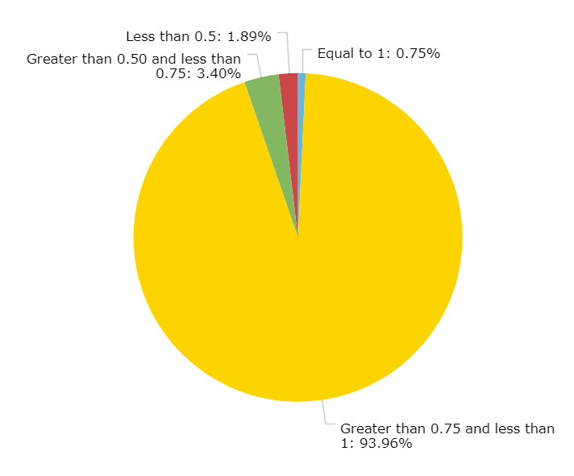
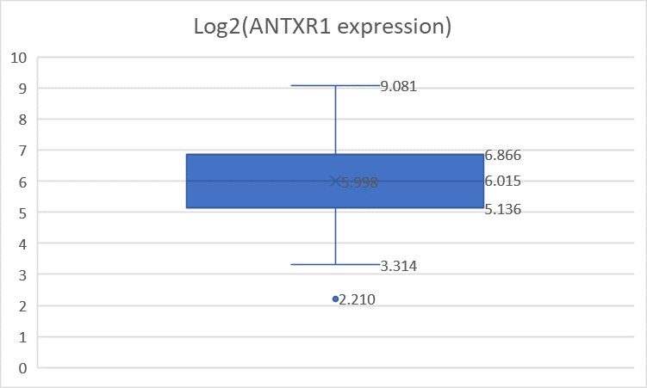
Using the SVV Patient Screening Assay, it was possible to determine TEM8 was highly expressed in 94% of sarcoma tumors screened
Probability of SVV-sensitivity of 265 sarcoma tumors
TEM8 Expression is High in All Sarcoma Samples
Code | Probability of SVV-Sensitivity | # positive tumors
 | Equal to 1 | 2
 | Greater than 0.75 and less than 1 | 249 (94%)
 | Between 0.5 – 0.75 | 9
 | Less than 0.5 | 5

Slide 26
SVV-001 Patient Selection Test: Nearly 3,000 patient tumors tested for SVV-001 sensitivity without Interferon inhibition
(Tumors Tested)

Slide 27
Seneca Therapeutics
SVV-001 As Multiple IV Agent to Expand TEM8 Positive Patient Populations

Slide 28
SVV-001 intravenous safety profile as monotherapy in humans is benign
SVV was delivered via single systemic intravenous dose in 76 patients in three trials
  Phase I/II in NET Patients
  Phase I/II in Pediatric Patients
  Phase II in ES SCLC Patients
Highest dose of any oncolytic virus delivered systemically in 58 patients
  10E¹¹vp/kg or 2 x 10E9 TCID50/kg
One DLT-tumor pain successfully treated with analgesics
Benign Safety Profile
  AE’s were Grade 2 or Lower and Reversible

Slide 29
Intravenous Administration Program for SVV-001 could enable first OV treatment using multiple IV dosing
TEM8 Mechanism of Action allows for safe IV dosing
  SVV-001 has been safely dosed intravenously at 10¹¹ viral particles per kilogram in human trials as a single dose
  The SVV-001 I V dose is 70-150 fold higher than current IT doses being used by other oncolytic viruses
SVV-001 is not a human virus and no pre-treatment neutralizing antibody has been detected in humans
  Neutralizing antibody does occur at day 14 or later
  Company is currently looking at several different approaches to transiently reduce SVV-antibodies

Slide 30
Recent animal studies have shown multiple intravenous administration of SVV-001 is feasible
Up to 97 % decrease in neutralizing antibody titer with Cyclophosphamide or ImmTOR or a combination of both

Slide 31
SVV/Cyclophosphamide combination given IV in animal models has shown excellent suppression of SVV-001 neutralizing antibodies
250 mg/kg CPM on day -2
10⁹ vp/kg SVV IV on day 0
Enhanced anti-tumor activity
  Complete responses
Delay/decrease in Ab titer
  Window for repeat dosing
10⁹ vp/kp SVV
250 mg/kg CPM
10⁹ vp/kp SVV +
250 mg/kg CPM
SVV
SVV + CPM
CPM SVV
Syngeneic murine model (N1E-115)

Slide 32
Seneca Therapeutics
Comparable Companies to SVV-001 as
Oncolytic Virus
Multi-product platform

Slide 33






Oncolytic Virus Market Strong: Near-term exit possibility evidenced by recent spate of robust liquidity events
Most of these transactions are earlier than Seneca’s current stage
Oncorus $333M current valuation – Starting Phase I
Replimune $1.5B current valuation - Middle of Phase II
Acquired (Merck)
Phase 1/2
IPO
Phase 1/2
Acquired (JnJ)
Pre-clinical
IPO
Phase 1/2
Partnership (BMS)
Pre-clinical
Partnership (Takeda)
Pre-clinical
$394M
$420M
$1.04B
$328M
$936M
$900M
Notes:
Strategics are paying very nice multiples to acquire Oncolytic Viruses – and even on preclinical data alone. For example ViraTherapeutics was acquired for $245M on less preclinical data than we have now let alone after completing the milestones in the round of funding we are seeking not to mention they hadn’t ever been in clinical trials. The second option is to raise one more round of funding at a good valuation after this one and bring through Phase II trials by 2024 and then be acquired. Viralytics was acquired for $394M with Phase IB data alone-so we certainly think the upper end of this range for a therapeutic that can do what they did even better is quite feasible. Thus we plan on obtaining a 15-23X return for investors in this round

Slide 34





Selected Multi-product Platform Cancer Therapy Deals 2020-21
$4.7BB Acquisition
$2.8BB Acquisition
$4.0BB Acquisition
$630MM Acquisition
$695MM Licensing

Slide 35
Series B Convertible Round is $5M, a $25M Series B Round and possible $35M Series C Round
$ 5M Convertible Round
$25 Million Series B Round
$35 Series C Round
2021
2022
2023
2024
2025
Q2
Q3
Q4
Q3
Q4
Q4
Q4
Q1
Q2
Q3
Q4
Q1
Q2
Q3
Q4
Q1
Q2
Q3
Q1
Q2
$ 5M
$ 25M
$ 35M
Initial Human POC Results
Be Acquired
Clinical Trial in NET & NEC
1)Phase I/II Trial (SVV + Opdivo and Yervoy)
2) Phase III Comparative Trial with SVV + Opdivo and Yervoy vs Opdivo and Yervoy alone
Phase I/II SVV-001 plus Opdivo and Yervoy
Phase III Trial SVV-001 plus Opdivo and Yervoy vs Opdivo and Yervoy alone
End of Phase III Meeting
with FDA
BLA Filing FDA
Manufacturing
Transfer scaled up manufacturing process to CMO and make new SVV-001 Lot
Development of Multiple IV Products
Development of Multiple IV Products
Armed SVV
Constructs
Development of Armed SVV Constructs

Slide 36
Summary Risk Factors
An investment in the Company is highly speculative and involves a high degree of risk. Only those investors who can bear the risk of loss of their entire investment should participate. In addition to the other information provided by the company, potential investors should carefully consider the following risk factors in evaluating an investment in the Company. These are not the only risk factors faced by the Company (See offering materials for additional information).
The Company may not raise the full amount of the proposed financing.
  Capital raised may not be sufficient to reach a licensing event, an exit or a follow-on financing.
  In that event, the Company may have to cut back operations and may be unable to pay license fees to intellectual property (“IP”) holders or meet other important obligations.
The Company’s product concept may take longer to prove or may not perform as expected, delaying or precluding further financing.
The Company may fail to attract the talent it needs to achieve its objectives.
The Company’s IP may infringe on others’ patents or it may not be sufficient to protect the Company against competition.
  The Company has not commissioned a freedom-to-operate opinion; it is possible the Company’s IP infringes on someone else’s patent estate.
  The Company may need to assert its IP rights against other parties and the IP may not prove adequate to block imitators.
The product may fail in clinical trials due to safety problems or failure to demonstrate efficacy sufficient to gain approval from the FDA
The product may not receive favorable reimbursement treatment from public and/or private insurers
Revenues from products may be lower than projected, reducing the milestones & royalty payments Seneca expects from licensees.
Seneca relies heavily on third parties for product development and manufacturing expertise; those third parties may not deliver or may insist on unaffordable payment.
Seneca may not be able to raise additional capital if needed, or on terms that would be acceptable to existing owners
  The Company may need more money than anticipated to complete regulatory requirements and the costs of launching the product
  Capital may need to be raised at a lower valuation, diluting existing owners
The Company’s discussions with potential licensees and partners might not mature into binding commitments.
Competing products or technologies may emerge which are superior to the Company’s products and technologies.
Competing products or technologies may emerge which are superior to Seneca’s prospective strategic partners’ products
The target markets for the Company’s products may not materialize or may diminish in unanticipated ways.
The Company may not be adept at marketing its products and may not be able to partner with a marketing company to do so.
Notes:
Just wanted to share with you briefly the usual risk factors for an early stage life sciences company and will be in the deck and DD document we send you.

Slide 37
Safe Harbor Statement and Disclaimer
This presentation contains “forward-looking statements” pursuant to the safe harbor provisions of the Private Securities Litigation Reform Act of 1995. Forward-looking statements include, without limitation, any statement that may predict, forecast, indicate, or imply future results, performance or achievements, and may contain the words "estimate," "intend," "target,” “will," “is likely,” "would," "may," or, in each case, their negative, or words or expressions of similar meaning. These forward-looking statements are found at various places throughout this presentation and include information concerning possible or assumed future results of our operations; business strategies; future cash flows; financing plans; plans and objectives of management; any other statements regarding future operations, future cash needs, business plans and future financial results, and any other statements that are not historical facts. Unless otherwise indicated, the terms “Seneca”, “STI” “Company,” “we,” “us” and “our” refer to Seneca Therapeutics, Inc. Any or all of the forward-looking statements included in this presentation are not guarantees of future performance and may turn out to be inaccurate. These forward-looking statements represent our intentions, plans, expectations, assumptions and beliefs about future events and are subject to risks, uncertainties and other factors. Many of those factors are outside of our control and could cause actual results to differ materially from the results expressed or implied by those forward-looking statements. Although these expectations may change, we are under no obligation to inform you if they do. Actual events or results may differ materially from those contained in the forward-looking statements. The following factors, among others, could cause our actual results to differ materially from those described in a forward-looking statement: our history of losses; competition, inability to achieve regulatory approval for our device, technology systems beyond our control and technology-related defects that could affect the companies’ products or reputation; risks related to adverse business conditions; our dependence on key employees; competition for qualified personnel; the possible unavailability of financing as and if needed; risks related to protecting our intellectual property rights or potential infringement of the intellectual property rights of third parties; and potential fluctuations in our quarterly and annual results. This list is intended to identify only certain of the principal factors that could cause actual results to differ from those discussed in the forward-looking statements. In light of these risks, uncertainties and assumptions, the events described in the forward-looking statements might not occur or might occur to a different extent or at a different time than we have described. You are cautioned not to place undue reliance on these forward-looking statements, which speak only as of the date of the applicable presentation. You are referred to a discussion of important risk factors detailed in the Company’s offering materials. THE SECURITIES THAT THE COMPANY IS OFFERING ARE HIGHLY SPECULATIVE IN NATURE AND INVOLVE A HIGH DEGREE OF RISK. A POTENTIAL INVESTOR SHOULD CONSIDER VERY CAREFULLY THE RISKS AND SPECULATIVE FACTORS INHERENT IN AND AFFECTING THE COMPANY’S BUSINESS PRIOR TO THE PURCHASE OF ANY OF THE UNITS OR OTHER SECURITIES, INCLUDING, WITHOUT LIMITATION, THE RISK FACTORS ENUMERATED ABOVE. You are referred to a discussion of important risk factors detailed in the Company’s offering materials.
Notes:
The usual Safe Harbor statement-also will be in materials.

Slide 38
Seneca Therapeutics
Questions

Slide 39
Seneca Therapeutics CEO James Hussey has raised over $600 million and returned 4.86x to investors
1995-2021
$616 million raised
$741 million pre money valuation
3.6 billion at either a) IPO and my exit or b) sale of company
48 deals in pharma or biotech
Notes:
Good afternoon. We are only giving a brief high level overview and update today due to the time restraints but would urge anyone with interest to hear more about what we believe is a tremendous opportunity not only for investors but also for cancer patients. Thus we have scheduled this follow-up event-just need to mark interest on your gold sheet or e-mail me at the address at the bottom of the screen and mark the date. Of course be happy to have a separate call with you if you cant make it. Thank you.

